Slide 1

Computer Networking & Comm
Module 7 :Network Security
By
Engr. Prof. Steve A. Adeshina
Prof. S.A Adeshina
NILE

Slide 2
Acknowledgement
Computer Networking: A Top Down Approach 6th edition Jim Kurose, Keith Ross Addison-Wesley March 2012
Prof. S.A Adeshina
NILE

Slide 3
Chapter 8: Network Security
Chapter goals:
understand principles of network security:
cryptography and its many uses beyond “confidentiality”
authentication
message integrity
security in practice:
firewalls and intrusion detection systems
security in application, transport, network, link layers
Prof. S.A Adeshina
NILE

Slide 4
Chapter 8 roadmap
8.1 What is network security?
8.2 Principles of cryptography
8.3 Message integrity, authentication
8.4 Securing e-mail
8.5 Securing TCP connections: SSL
8.6 Network layer security: IPsec
8.7 Securing wireless LANs
8.8 Operational security: firewalls and IDS
Prof. S.A Adeshina
NILE

Slide 5
What is network security?
confidentiality: only sender, intended receiver should “understand” message contents
sender encrypts message
receiver decrypts message
authentication: sender, receiver want to confirm identity of each other
message integrity: sender, receiver want to ensure message not altered (in transit, or afterwards) without detection
access and availability: services must be accessible and available to users
Prof. S.A Adeshina
NILE

Slide 6



Friends and enemies: Alice, Bob, Trudy
well-known in network security world
Bob, Alice (lovers!) want to communicate “securely”
Trudy (intruder) may intercept, delete, add messages
Alice
Bob
channel
data, control messages
secure
sender
s
data
secure
receiver
data
Trudy
Prof. S.A Adeshina
NILE

Slide 7
Who might Bob, Alice be?
… well, real-life Bobs and Alices!
Web browser/server for electronic transactions (e.g., on-line purchases)
on-line banking client/server
DNS servers
routers exchanging routing table updates
other examples?
Prof. S.A Adeshina
NILE

Slide 8
There are bad guys (and girls) out there!
Q: What can a “bad guy” do?
A: A lot! See section
eavesdrop: intercept messages
actively insert messages into connection
impersonation: can fake (spoof) source address in packet (or any field in packet)
hijacking: “take over” ongoing connection by removing sender or receiver, inserting himself in place
denial of service: prevent service from being used by others (e.g., by overloading resources)
Prof. S.A Adeshina
NILE

Slide 9
Chapter 8 roadmap
8.1 What is network security?
8.2 Principles of cryptography
8.3 Message integrity, authentication
8.4 Securing e-mail
8.5 Securing TCP connections: SSL
8.6 Network layer security: IPsec
8.7 Securing wireless LANs
8.8 Operational security: firewalls and IDS
Prof. S.A Adeshina
NILE

Slide 10
The language of cryptography
Alice’s
encryption
key
Bob’s
decryption
key
K
K
A
B
plaintext
encryption
algorithm
ciphertext
decryption
algorithm
plaintext
m plaintext message
K_{A}(m) ciphertext, encrypted with key K_{A}
m = K_{B}(K_{A}(m))

Slide 11
Breaking an encryption scheme
cipher-text only attack: Trudy has ciphertext she can analyze
two approaches:
brute force: search through all keys
statistical analysis
known-plaintext attack: Trudy has plaintext corresponding to ciphertext
e.g., in monoalphabetic cipher, Trudy determines pairings for a,l,i,c,e,b,o,
chosen-plaintext attack: Trudy can get ciphertext for chosen plaintext
(The quick brown fox jumps over the lazy dog)
Prof. S.A Adeshina
NILE

Slide 12
Symmetric key cryptography
K
K
S
S
plaintext
message, m
encryption
algorithm
ciphertext
decryption
algorithm
plaintext
K (m)
m = K_{S}(K_{S}(m))
S
symmetric key crypto: Bob and Alice share same (symmetric) key: K
e.g., key is knowing substitution pattern in mono alphabetic substitution cipher
Q: how do Bob and Alice agree on key value?
S

Slide 13
Simple encryption scheme
substitution cipher: substituting one thing for another
monoalphabetic cipher: substitute one letter for another
plaintext: abcdefghijklmnopqrstuvwxyz
ciphertext: mnbvcxzasdfghjklpoiuytrewq
e.g.:
Plaintext: bob. i love you. alice
ciphertext: nkn. s gktc wky. mgsbc
Encryption key: mapping from set of 26 letters
to set of 26 letters

Slide 14
A more sophisticated encryption approach
n substitution ciphers, M₁,M₂,…,M_{n}
cycling pattern:
e.g., n=4: M₁,M₃,M₄,M₃,M₂; M₁,M₃,M₄,M₃,M₂; ..
for each new plaintext symbol, use subsequent subsitution pattern in cyclic pattern
dog: d from M₁, o from M₃, g from M₄
Encryption key: n substitution ciphers, and cyclic pattern
key need not be just n-bit pattern

Slide 15
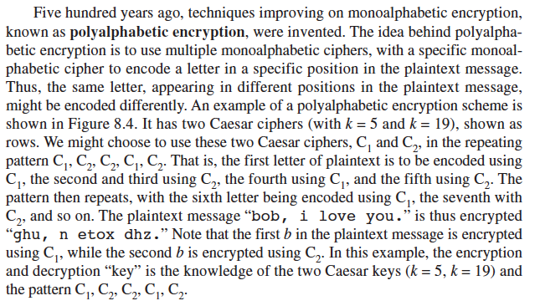
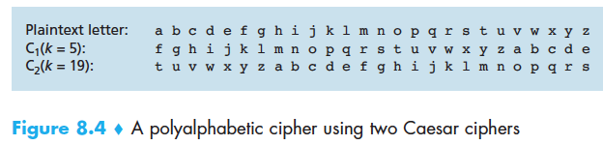
A more sophisticated encryption approach

Slide 16
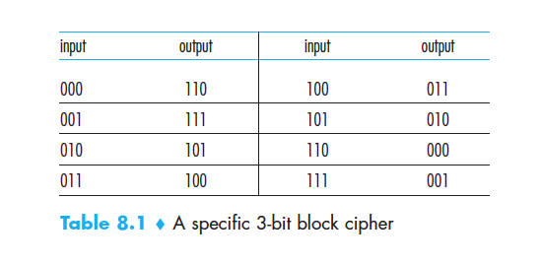
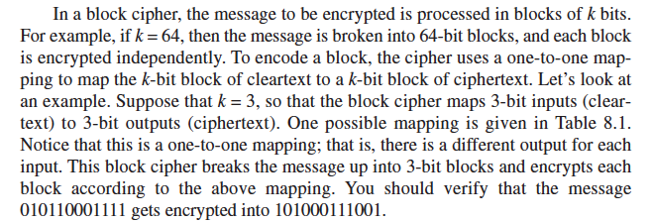
Block Ciphers

Slide 17

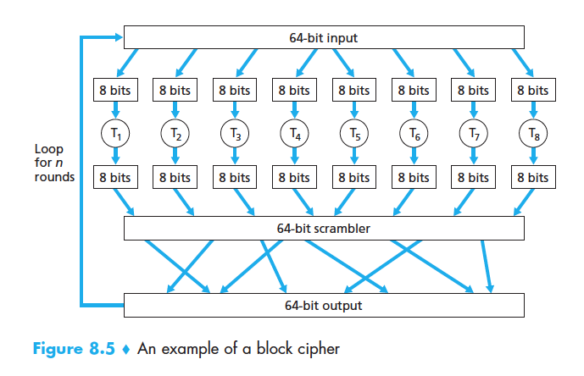

Block Ciphers

Slide 18
Symmetric key crypto: DES
DES: Data Encryption Standard
US encryption standard [NIST 1993]
56-bit symmetric key, 64-bit plaintext input
block cipher with cipher block chaining
how secure is DES?
DES Challenge: 56-bit-key-encrypted phrase decrypted (brute force) in less than a day
no known good analytic attack
making DES more secure:
3DES: encrypt 3 times with 3 different keys
Dr S.A Adeshina
NTNU

Slide 19
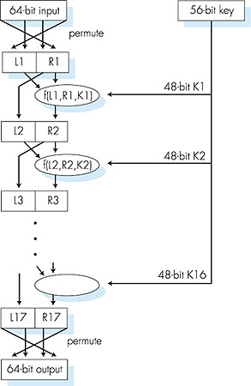
Symmetric key crypto: DES
DES operation
initial permutation
16 identical “rounds” of function application, each using different 48 bits of key
final permutation

Slide 20
AES: Advanced Encryption Standard
symmetric-key NIST standard, replaced DES (Nov 2001)
processes data in 128 bit blocks
128, 192, or 256 bit keys
brute force decryption (try each key) taking 1 sec on DES, takes 149 trillion years for AES

Slide 21
Public Key Cryptography
symmetric key crypto
requires sender, receiver know shared secret key
Q: how to agree on key in first place (particularly if never “met”)?
public key crypto
radically different approach [Diffie-Hellman76, RSA78]
sender, receiver do not share secret key
public encryption key known to all
private decryption key known only to receiver

Slide 22
Public key cryptography
+
Bob’s public
key
K
B
-
Bob’s private
key
K
B
plaintext
message, m
encryption
algorithm
ciphertext
decryption
algorithm
plaintext
message
+
K (m)
-
+
B
m = K (K (m))
B
B
Prof. S.A Adeshina
NILE

Slide 23
Public key encryption algorithms
requirements:
.
.
+
-
1
need K ( ) and K ( ) such that
B
B
-
+
K (K (m)) = m
B
B
2
+
given public key K , it should be impossible to compute private key K
B
-
B
RSA: Rivest, Shamir, Adelson algorithm

Slide 24
Prerequisite: modular arithmetic
x mod n = remainder of x when divide by n
facts:
[(a mod n) + (b mod n)] mod n = (a+b) mod n
[(a mod n) - (b mod n)] mod n = (a-b) mod n
[(a mod n) * (b mod n)] mod n = (a*b) mod n
thus
(a mod n)^{d} mod n = a^{d} mod n
example: x=14, n=10, d=2: (x mod n)^{d} mod n = 4² mod 10 = 6 x^{d} = 14² = 196 x^{d} mod 10 = 6

Slide 25
RSA: getting ready
message: just a bit pattern
bit pattern can be uniquely represented by an integer number
thus, encrypting a message is equivalent to encrypting a number.
example:
m= 10010001 . This message is uniquely represented by the decimal number 145.
to encrypt m, we encrypt the corresponding number, which gives a new number (the ciphertext).

Slide 26
RSA: Creating public/private key pair
1. choose two large prime numbers p, q.
(e.g., 1024 bits each)
2. compute n = pq, z = (p-1)(q-1)
3. choose e (with e<n) that has no common factors
with z (e, z are “relatively prime”).
4. choose d such that ed-1 is exactly divisible by z.
(in other words: ed mod z = 1 ).
5. public key is (n,e). private key is (n,d).
+
-
K
K
B
B

Slide 27
RSA: encryption, decryption
0. given (n,e) and (n,d) as computed above
1. to encrypt message m (<n), compute
e
c = m mod n
2. to decrypt received bit pattern, c, compute
d
m = c mod n
magic
happens!
e
d
m = (m mod n)
mod n
c

Slide 28
RSA example:
Bob chooses p=5, q=7. Then n=35, z=24.
e=5 (so e, z relatively prime).
d=29 (so ed-1 exactly divisible by z).
encrypting 8-bit messages.
m
e
e
bit pattern
m
c = m mod n
encrypt:
0000l000
12
24832
17
d
d
c
c
m = c mod n
decrypt:
17
481968572106750915091411825223071697
12

Slide 29
Why does RSA work?
must show that c^{d} mod n = m where c = m^{e} mod n
fact: for any x and y: x^{y} mod n = x^{(y mod z)} mod n
where n= pq and z = (p-1)(q-1)
thus, c^{d} mod n = (m^{e} mod n)^{d} mod n
= m^{ed} mod n
= m^{(ed mod z)} mod n
= m¹ mod n
= m

Slide 30
RSA: another important property
The following property will be very useful later:
-
+
+
-
K (K (m)) = m
=
K (K (m))
B
B
B
B
use public key first, followed by private key
use private key first, followed by public key
result is the same!

Slide 31
Why
-
+
+
-
K (K (m)) = m
?
=
K (K (m))
B
B
B
B
follows directly from modular arithmetic:
(m^{e} mod n)^{d} mod n = m^{ed} mod n
= m^{de} mod n
= (m^{d} mod n)^{e} mod n

Slide 32
Why is RSA secure?
suppose you know Bob’s public key (n,e). How hard is it to determine d?
essentially need to find factors of n without knowing the two factors p and q
fact: factoring a big number is hard

Slide 33
RSA in practice: session keys
exponentiation in RSA is computationally intensive
DES is at least 100 times faster than RSA
use public key cryto to establish secure connection, then establish second key – symmetric session key – for encrypting data
session key, K_{S}
Bob and Alice use RSA to exchange a symmetric key K_{S}
once both have K_{S}, they use symmetric key cryptography

Slide 34
Chapter 8 roadmap
8.1 What is network security?
8.2 Principles of cryptography
8.3 Message integrity, authentication
8.4 Securing e-mail
8.5 Securing TCP connections: SSL
8.6 Network layer security: IPsec
8.7 Securing wireless LANs
8.8 Operational security: firewalls and IDS

Slide 35
Authentication
Goal: Bob wants Alice to “prove” her identity to him
Protocol ap1.0: Alice says “I am Alice”
“I am Alice”
Failure scenario??

Slide 36
Authentication
Goal: Bob wants Alice to “prove” her identity to him
Protocol ap1.0: Alice says “I am Alice”
in a network,
Bob can not “see” Alice, so Trudy simply declares
herself to be Alice
“I am Alice”

Slide 37
Authentication: another try
Protocol ap2.0: Alice says “I am Alice” in an IP packet
containing her source IP address
Alice’s
IP address
“I am Alice”
Failure scenario??

Slide 38
Authentication: another try
Protocol ap2.0: Alice says “I am Alice” in an IP packet
containing her source IP address
Trudy can create
a packet “spoofing”
Alice’s address
Alice’s
IP address
“I am Alice”

Slide 39
Authentication: another try
Protocol ap3.0: Alice says “I am Alice” and sends her
secret password to “prove” it.
Alice’s
IP addr
Alice’s
password
“I’m Alice”
Failure scenario??
Alice’s
IP addr
OK

Slide 40
Authentication: another try
Protocol ap3.0: Alice says “I am Alice” and sends her
secret password to “prove” it.
Alice’s
IP addr
Alice’s
password
“I’m Alice”
playback attack: Trudy records Alice’s packet
and later
plays it back to Bob
Alice’s
IP addr
OK
Alice’s
IP addr
Alice’s
password
“I’m Alice”

Slide 41
Authentication: yet another try
Protocol ap3.1: Alice says “I am Alice” and sends her
encrypted secret password to “prove” it.
Alice’s
IP addr
encrypted
password
“I’m Alice”
Failure scenario??
Alice’s
IP addr
OK

Slide 42
Authentication: yet another try
Protocol ap3.1: Alice says “I am Alice” and sends her
encrypted secret password to “prove” it.
Alice’s
IP addr
encrypted
password
“I’m Alice”
record
and
playback
still works!
Alice’s
IP addr
OK
Alice’s
IP addr
encrypted
password
“I’m Alice”

Slide 43
Authentication: yet another try
Goal: avoid playback attack
nonce: number (R) used only once-in-a-lifetime
ap4.0: to prove Alice “live”, Bob sends Alice nonce, R. Alice
must return R, encrypted with shared secret key
“I am Alice”
R
K (R)
Alice is live, and only Alice knows key to encrypt nonce, so it must be Alice!
A-B
Failures, drawbacks?

Slide 44
Authentication: ap5.0
ap4.0 requires shared symmetric key
can we authenticate using public key techniques?
ap5.0: use nonce, public key cryptography
“I am Alice”
Bob computes
R
+
-
-
K
(K (R)) = R
K (R)
A
A
A
and knows only Alice could have the private key, that encrypted R such that
“send me your public key”
+
K
A
+
-
K
(K (R)) = R
A
A

Slide 45
ap5.0: security hole
man (or woman) in the middle attack: Trudy poses as Alice (to Bob) and as Bob (to Alice)
difficult to detect:
Bob receives everything that Alice sends, and vice versa. (e.g., so Bob, Alice can meet one week later and recall conversation!)
problem is that Trudy receives all messages as well!

Slide 46
Chapter 8 roadmap
8.1 What is network security?
8.2 Principles of cryptography
8.3 Message integrity, authentication
8.4 Securing e-mail
8.5 Securing TCP connections: SSL
8.6 Network layer security: IPsec
8.7 Securing wireless LANs
8.8 Operational security: firewalls and IDS

Slide 47
Digital signatures
cryptographic technique analogous to hand-written signatures:
sender (Bob) digitally signs document, establishing he is document owner/creator.
verifiable, nonforgeable: recipient (Alice) can prove to someone that Bob, and no one else (including Alice), must have signed document

Slide 48
Digital signatures
simple digital signature for message m:
Bob signs m by encrypting with his private key K_{B}, creating “signed” message, K_{B}(m)
-
-
Bob’s message, m
-
Bob’s private
key
-
K
m,K
(m)
B
B
Dear Alice
Oh, how I have missed you. I think of you all the time! …(blah blah blah)
Bob
Bob’s message, m, signed (encrypted) with his private key
Public key
encryption
algorithm

Slide 49
Digital signatures
-
suppose Alice receives msg m, with signature: m, K_{B}(m)
Alice verifies m signed by Bob by applying Bob’s public key K_{B} to K_{B}(m) then checks K_{B}(K_{B}(m) ) = m.
If K_{B}(K_{B}(m) ) = m, whoever signed m must have used Bob’s private key.
+
-
+
-
+
-
Alice thus verifies that:
Bob signed m
no one else signed m
Bob signed m and not m‘
non-repudiation:
Alice can take m, and signature K_{B}(m) to court and prove that Bob signed m
-

Slide 50
Message digests
large
message
m
H: Hash
Function
computationally expensive to public-key-encrypt long messages
goal: fixed-length, easy- to-compute digital “fingerprint”
apply hash function H to m, get fixed size message digest, H(m).
H(m)
Hash function properties:
many-to-1
produces fixed-size msg digest (fingerprint)
given message digest x, computationally infeasible to find m such that x = H(m)

Slide 51
Internet checksum: poor crypto hash function
Internet checksum has some properties of hash function:
produces fixed length digest (16-bit sum) of message
is many-to-one
But given message with given hash value, it is easy to find another message with same hash value:
message
ASCII format
message
ASCII format
I O U 1
0 0 . 9
9 B O B
49 4F 55 31
30 30 2E 39
39 42 D2 42
I O U 9
0 0 . 1
9 B O B
49 4F 55 39
30 30 2E 31
39 42 D2 42
B2 C1 D2 AC
different messages
but identical checksums!
B2 C1 D2 AC

Slide 52
Digital signature = signed message digest
Bob sends digitally signed message:
Alice verifies signature, integrity of digitally signed message:
large
message
m
H: Hash
function
H(m)
encrypted
msg digest
-
K_{B}(H(m))
Bob’s
private
key
digital
signature
(encrypt)
large
message
m
-
Bob’s
public
key
digital
signature
(decrypt)
K
B
+
H: Hash
function
K
encrypted
msg digest
B
+
-
K_{B}(H(m))
H(m)
H(m)
equal
?

Slide 53
Hash function algorithms
MD5 hash function widely used (RFC 1321)
computes 128-bit message digest in 4-step process.
arbitrary 128-bit string x, appears difficult to construct msg m whose MD5 hash is equal to x
SHA-1 is also used
US standard [NIST, FIPS PUB 180-1]
160-bit message digest

Slide 54
Public-key certification
motivation: Trudy plays pizza prank on Bob
Trudy creates e-mail order: Dear Pizza Store, Please deliver to me four pepperoni pizzas. Thank you, Bob
Trudy signs order with her private key
Trudy sends order to Pizza Store
Trudy sends to Pizza Store her public key, but says it’s Bob’s public key
Pizza Store verifies signature; then delivers four pepperoni pizzas to Bob
Bob doesn’t even like pepperoni

Slide 55
Certification authorities
certification authority (CA): binds public key to particular entity, E.
E (person, router) registers its public key with CA.
E provides “proof of identity” to CA.
CA creates certificate binding E to its public key.
certificate containing E’s public key digitally signed by CA – CA says “this is E’s public key”
Bob’s
public
key
digital
signature
(encrypt)
+
K
+
B
K
B
CA
private
key
certificate for Bob’s public key, signed by CA
-
Bob’s
identifying information
K
CA

Slide 56
Certification authorities
when Alice wants Bob’s public key:
gets Bob’s certificate (Bob or elsewhere).
apply CA’s public key to Bob’s certificate, get Bob’s public key
+
digital
signature
(decrypt)
Bob’s
public
key
K
B
+
K
B
CA
public
key
+
K
CA

Slide 57
Chapter 8 roadmap
8.1 What is network security?
8.2 Principles of cryptography
8.3 Message integrity, authentication
8.4 Securing e-mail
8.5 Securing TCP connections: SSL
8.6 Network layer security: IPsec
8.7 Securing wireless LANs
8.8 Operational security: firewalls and IDS

Slide 58
Secure e-mail
Alice wants to send confidential e-mail, m, to Bob.
K_{S}
.
K_{S}(m )
K_{S}(m )
.
m
K_{S}( )
K_{S}( )
m
+
-
Internet
K_{S}
.
.
+
-
K_{S}
K_{B}( )
+
+
K_{B}( )
K_{B}(K_{S} )
K_{B}(K_{S} )
+
-
K_{B}
K_{B}
Alice:
generates random symmetric private key, K_{S}
encrypts message with K_{S} (for efficiency)
also encrypts K_{S} with Bob’s public key
sends both K_{S}(m) and K_{B}(K_{S}) to Bob

Slide 59
Secure e-mail
Alice wants to send confidential e-mail, m, to Bob.
K_{S}
.
K_{S}(m )
K_{S}(m )
.
m
K_{S}( )
K_{S}( )
m
+
-
Internet
K_{S}
.
.
+
-
K_{S}
K_{B}( )
+
+
K_{B}( )
K_{B}(K_{S} )
K_{B}(K_{S} )
+
-
K_{B}
K_{B}
Bob:
uses his private key to decrypt and recover K_{S}
uses K_{S} to decrypt K_{S}(m) to recover m

Slide 60
Secure e-mail (continued)
Alice wants to provide sender authentication message integrity
-
+
K_{A}
K_{A}
.
.
-
-
.
-
K_{A}(H(m))
K_{A}(H(m))
+
H(m )
m
H( )
K_{A}( )
K_{A}( )
+
-
compare
Internet
.
m
H( )
H(m )
m
Alice digitally signs message
sends both message (in the clear) and digital signature

Slide 61
Secure e-mail (continued)
Alice wants to provide secrecy, sender authentication, message integrity.
-
K_{A}
.
.
-
-
K_{A}(H(m))
K_{S}
m
H( )
K_{A}( )
.
+
K_{S}( )
m
+
Internet
.
+
K_{S}
K_{B}( )
+
K_{B}(K_{S} )
+
K_{B}
Alice uses three keys: her private key, Bob’s public key, newly created symmetric key

Slide 62
Chapter 8 roadmap
8.1 What is network security?
8.2 Principles of cryptography
8.3 Message integrity
8.4 Securing e-mail
8.5 Securing TCP connections: SSL
8.6 Network layer security: IPsec
8.7 Securing wireless LANs
8.8 Operational security: firewalls and IDS

Slide 63
SSL: Secure Sockets Layer
widely deployed security protocol
supported by almost all browsers, web servers
https
billions $/year over SSL
mechanisms: [Woo 1994], implementation: Netscape
variation -TLS: transport layer security, RFC 2246
provides
confidentiality
integrity
authentication
original goals:
Web e-commerce transactions
encryption (especially credit-card numbers)
Web-server authentication
optional client authentication
minimum hassle in doing business with new merchant
available to all TCP applications
secure socket interface

Slide 64
SSL and TCP/IP
Application
Application
SSL
TCP
TCP
IP
IP
normal application
application with SSL
SSL provides application programming interface (API) to applications
C and Java SSL libraries/classes readily available

Slide 65
Chapter 8 roadmap
8.1 What is network security?
8.2 Principles of cryptography
8.3 Message integrity
8.4 Securing e-mail
8.5 Securing wireless LANs
8.6 Operational security: firewalls and IDS

Slide 66
What is network-layer confidentiality ?
between two network entities:
sending entity encrypts datagram payload, payload could be:
TCP or UDP segment, ICMP message, OSPF message ….
all data sent from one entity to other would be hidden:
web pages, e-mail, P2P file transfers, TCP SYN packets …
“blanket coverage”

Slide 67
Virtual Private Networks (VPNs)
motivation:
institutions often want private networks for security.
costly: separate routers, links, DNS infrastructure.
VPN: institution’s inter-office traffic is sent over public Internet instead
encrypted before entering public Internet
logically separate from other traffic

Slide 68



Virtual Private Networks (VPNs)
public Internet
laptop
w/ IPsec
IP
header
IPsec
header
Secure
payload
salesperson in hotel
IP
header
IPsec
header
Secure
payload
IP
header
IPsec
header
Secure
payload
router w/
IPv4 and IPsec
router w/
IPv4 and IPsec
IP
header
payload
IP
header
payload
branch office
headquarters

Slide 69
IPsec services
data integrity
origin authentication
replay attack prevention
confidentiality
two protocols providing different service models:
AH
ESP

Slide 70


Firewalls
firewall
isolates organization’s internal net from larger Internet, allowing some packets to pass, blocking others
administered
network
public
Internet
trusted “good guys”
untrusted “bad guys”
firewall

Slide 71
Firewalls: why
prevent denial of service attacks:
SYN flooding: attacker establishes many bogus TCP connections, no resources left for “real” connections
prevent illegal modification/access of internal data
e.g., attacker replaces CIA’s homepage with something else
allow only authorized access to inside network
set of authenticated users/hosts
three types of firewalls:
stateless packet filters
stateful packet filters
application gateways

Slide 72
Stateless packet filtering
Should arriving packet be allowed in? Departing packet let out?
internal network connected to Internet via router firewall
router filters packet-by-packet, decision to forward/drop packet based on:
source IP address, destination IP address
TCP/UDP source and destination port numbers
ICMP message type
TCP SYN and ACK bits

Slide 73
Stateless packet filtering: example
example 1: block incoming and outgoing datagrams with IP protocol field = 17 and with either source or dest port = 23
result: all incoming, outgoing UDP flows and telnet connections are blocked
example 2: block inbound TCP segments with ACK=0.
result: prevents external clients from making TCP connections with internal clients, but allows internal clients to connect to outside.

Slide 74
Stateless packet filtering: more examples
Policy | Firewall Setting
No outside Web access. | Drop all outgoing packets to any IP address, port 80
No incoming TCP connections, except those for institution’s public Web server only. | Drop all incoming TCP SYN packets to any IP except 130.207.244.203, port 80
Prevent Web-radios from eating up the available bandwidth. | Drop all incoming UDP packets - except DNS and router broadcasts.
Prevent your network from being used for a smurf DoS attack. | Drop all ICMP packets going to a “broadcast” address (e.g. 130.207.255.255).
Prevent your network from being tracerouted | Drop all outgoing ICMP TTL expired traffic

Slide 75
Access Control Lists
ACL: table of rules, applied top to bottom to incoming packets: (action, condition) pairs
action | source address | dest address | protocol | source port | dest port | flag bit
allow | 222.22/16 | outside of 222.22/16 | TCP | > 1023 | 80 | any
allow | outside of 222.22/16 | 222.22/16 | TCP | 80 | > 1023 | ACK
allow | 222.22/16 | outside of 222.22/16 | UDP | > 1023 | 53 | ---
allow | outside of 222.22/16 | 222.22/16 | UDP | 53 | > 1023 | ----
deny | all | all | all | all | all | all

Slide 76
Stateful packet filtering
stateless packet filter: heavy handed tool
admits packets that “make no sense,” e.g., dest port = 80, ACK bit set, even though no TCP connection established:
action | source address | dest address | protocol | source port | dest port | flag bit
allow | outside of 222.22/16 | 222.22/16 | TCP | 80 | > 1023 | ACK
stateful packet filter: track status of every TCP connection
track connection setup (SYN), teardown (FIN): determine whether incoming, outgoing packets “makes sense”
timeout inactive connections at firewall: no longer admit packets

Slide 77
Stateful packet filtering
ACL augmented to indicate need to check connection state table before admitting packet
action | source address | dest address | proto | source port | dest port | flag bit | check conxion
allow | 222.22/16 | outside of 222.22/16 | TCP | > 1023 | 80 | any
allow | outside of 222.22/16 | 222.22/16 | TCP | 80 | > 1023 | ACK | x
allow | 222.22/16 | outside of 222.22/16 | UDP | > 1023 | 53 | ---
allow | outside of 222.22/16 | 222.22/16 | UDP | 53 | > 1023 | ---- | x
deny | all | all | all | all | all | all

Slide 78
Application gateways
gateway-to-remote
host telnet session
host-to-gateway
telnet session
filters packets on application data as well as on IP/TCP/UDP fields.
example: allow select internal users to telnet outside.
application
gateway
router and filter
1. require all telnet users to telnet through gateway.
2. for authorized users, gateway sets up telnet connection to dest host. Gateway relays data between 2 connections
3. router filter blocks all telnet connections not originating from gateway.

Slide 79
Application gateways
filter packets on application data as well as on IP/TCP/UDP fields.
example: allow select internal users to telnet outside
host-to-gateway
telnet session
application
gateway
router and filter
gateway-to-remote
host telnet session
1. require all telnet users to telnet through gateway.
2. for authorized users, gateway sets up telnet connection to dest host. Gateway relays data between 2 connections
3. router filter blocks all telnet connections not originating from gateway.

Slide 80
Limitations of firewalls, gateways
IP spoofing: router can’t know if data “really” comes from claimed source
if multiple app’s. need special treatment, each has own app. gateway
client software must know how to contact gateway.
e.g., must set IP address of proxy in Web browser
filters often use all or nothing policy for UDP
tradeoff: degree of communication with outside world, level of security
many highly protected sites still suffer from attacks
Dr S.A Adeshina
NTNU
CSC605

Slide 81
Intrusion detection systems
packet filtering:
operates on TCP/IP headers only
no correlation check among sessions
IDS: intrusion detection system
deep packet inspection: look at packet contents (e.g., check character strings in packet against database of known virus, attack strings)
examine correlation among multiple packets
port scanning
network mapping
DoS attack
Prof. S.A Adeshina
NILE

Slide 82
Intrusion detection systems
multiple IDSs: different types of checking at different locations
firewall
internal
network
Internet
IDS
sensors
Web
server
DNS
server
FTP
server
demilitarized
zone

Slide 83
Network Security (summary)
basic techniques…...
cryptography (symmetric and public)
message integrity
end-point authentication
…. used in many different security scenarios
secure email
secure transport (SSL)
IP sec
802.11
operational security: firewalls and IDS
Prof. S.A Adeshina
NILE

Slide 84
End of Module 7
Prof. S.A Adeshina
NILE

